Slide 1
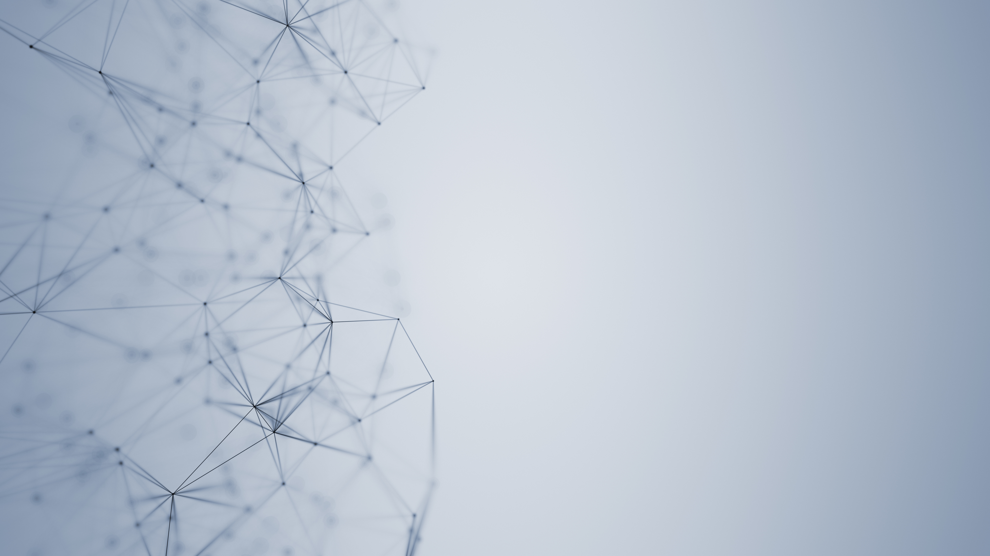
Waterfall & Agile Methodologies
Presented by Hemalatha

Slide 2
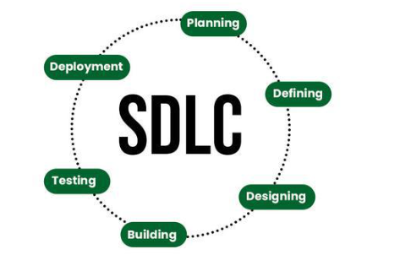
SDLC:
The Software Development Life Cycle (SDLC) is a structured process used by software developers to design, develop, test, and maintain software applications. It provides a systematic approach to building software, ensuring high quality and efficiency throughout the development process.

Slide 3
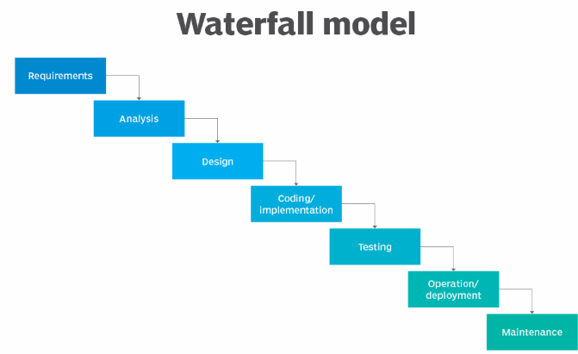
Waterfall Model:
The Waterfall Model is a linear and sequential software development methodology where each phase of the development process must be completed before the next phase begins.

Slide 4
Advantages and disadvantages of waterfall model:
Advantages
Easy to understand and follow.
Works well for projects with clear requirements.
Requirements are gathered early on.
Simple testing and integration process.
Progress is easy to track as each phase has specific deliverables and milestones.
Disadvantages
Hard to make changes once a phase is complete.
Not suitable for complex or large projects.
No user feedback until the end of the project.
Testing is done too late in the process.
Assumes that all requirements can be defined at the start, which may not always be the case.

Slide 5
Why waterfall can be better than agile...?
Clear and Fixed Requirements: Waterfall works best when the project’s requirements are well-defined and unlikely to change, as all requirements are gathered upfront.
Structured and Predictable Process: The linear, step-by-step approach of Waterfall makes it easier to manage timelines, budgets, and project milestones, offering greater predictability.
Minimal Client Involvement: Once the requirements are defined, Waterfall requires less ongoing client involvement, which is ideal for clients who prefer a more hands-off approach.
Better for Smaller or Simpler Projects: Waterfall is more efficient for projects with a clear scope and minimal complexity, where a fixed process and outcome are expected.

Slide 6
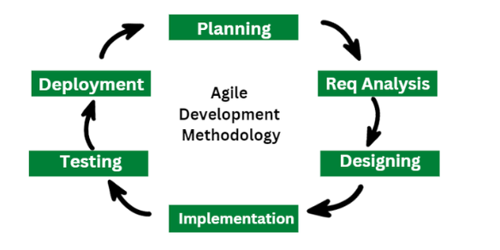
Agile Methodology:
Agile methodology is a flexible approach to software development where work is done in small, manageable stages called sprints. It focuses on collaboration, regular feedback, and the ability to adapt to changing requirements. The goal is to deliver working software quickly and continuously improve it based on customer needs.

Slide 7
Advantages and disadvantages of Agile:
Advantages
Easily adapts to changes in requirements.
Frequent feedback ensures the product meets customer needs.
Deliver working software in short cycles (sprints).
Regular testing in each sprint ensures fewer bugs.
Disadvantages
Lacks detailed planning, which can lead to scope.
Clients need to be available for regular reviews and feedback.
Requires a dedicated, skilled team and continuous communication.
It's difficult to estimate the total time or cost of the project upfront.

Slide 8
Why agile can be better than waterfall...?
Flexibility: Agile adapts to changes in requirements throughout the project; Waterfall does not.
Faster Delivery: Agile delivers working software in small increments, while Waterfall delivers the final product at the end.
Customer Involvement: Agile involves the customer regularly for feedback; Waterfall only involves them at the beginning and end.
Risk Management: Agile identifies and addresses risks early in each sprint, while Waterfall risks are discovered late.
Collaboration: Agile promotes constant collaboration between teams, while Waterfall has more isolated phases.

Slide 9

Thank you

